Slide 1
The Zipper
Joel Wright

Slide 2
Introduction
A Zipper is useful when you want to maintain a focal point within an inductively defined data type. Example usages include:
Text Editors
XMonad Window Lists
This presentation introduces the Zipper in the context of a simple binary search tree, but...
the Zipper can be applied to any inductively defined data type.

Slide 3
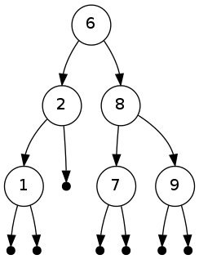
A simple binary search tree
data Tree a = Leaf
| Node a (Tree a) (Tree a)

Slide 4
Adding a focus of interest
Now we need to add a focus of interest to our tree. A simple approach might be to describe a path to the node we're currently interested in:
data Direction = L | R
type Directions = [Direction]
and a new type of tree that combines our previous definition with a path to the node:
type FocusTree a = (Tree a, Directions)

Slide 5
Modifying the tree
modifyFocus :: FocusTree a → (Tree a → Tree a) → FocusTree a
modifyFocus (t, ds) f = let t' = modifyF' t ds f
in t' `seq` (t',ds)
modifyF' :: Tree a → Directions → (Tree a → Tree a) → Tree amodifyF' t [] f = f t
modifyF' (Node x l r) (L:ds) f = let l' = modifyF' l ds f in l' `seq` (Node x l' r)modifyF' (Node x l r) (R:ds) f = let r' = modifyF' r ds f in r' `seq` (Node x l r')
modifyF' _ _ _ = error "Can't move down from a Leaf"
The `seq` calls are a necessary optimisation for the demo code in the repository, and we've just had a presentation on performance and optimisation, so I thought I'd leave them in. Without them we get a stack overflow on large numbers (>500,000) of tree modifications.

Slide 6
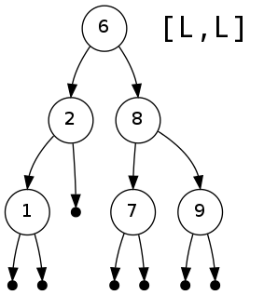
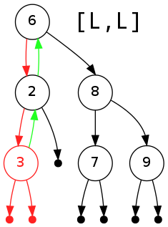
Problem with this approach
Every time we want to inspect or modify the focus of interest we must traverse the Tree.
→

Slide 7
How can we do better?
Modifying the tree is expensive, but how can we improve the situation?
We can't avoid the cost of modifying the bit of the Tree that we're interested in, but can we;
avoid the cost of traversing the tree?
move the focal point cheaply?
That's where the idea of a Zipper comes in...

Slide 8
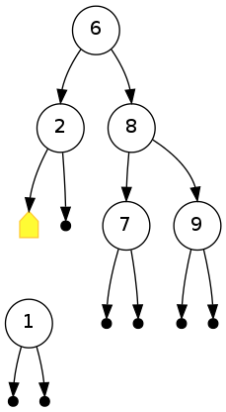
Keeping things in context
First, let's throw away the simple idea of "directions" to our focal point. Instead, let's build a data type that keeps track of our movements around the tree:
data Context a = CRoot | CLeft (Context a)
(a, Tree a) | CRight (Context a)
(a, Tree a)
type ZipTree a = (Context a, Tree a)
mkZipTree :: Tree a -> ZipTree a mkZipTree t = (CRoot, t)

Slide 9
Moving around the Zipper tree
left :: ZipTree a → ZipTree aleft (c, Node x l r) = (CLeft c (x,r), l)left _ = error "Can't move down from a Leaf"
right :: ZipTree a → ZipTree aright (c, Node x l r) = (CRight c (x,l), r)right _ = error "Can't move down from a Leaf"
up :: ZipTree a → ZipTree aup (CLeft c (x,r), t) = (c, Node x t r)up (CRight c (x,l), t) = (c, Node x l t)up _ = error "Can't go up from the root of the Tree"
top :: ZipTree a → ZipTree atop z@(CRoot, t) = ztop z = top.up $ z

Slide 10
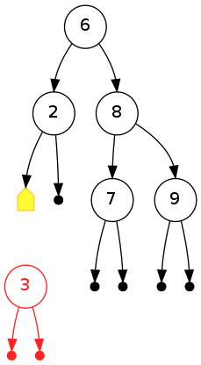
Modifying the Zipper tree
modify :: ZipTree a → (Tree a → Tree a) → ZipTree amodify (c, t) f = let t' = f t in t' `seq` (c, t')
→

Slide 11
What have we achieved?
We still have a tree that we can traverse and gives us access to our focal point, but we now have:
O(1) Access to our focus of interest.
Cheap movements around the type.
Efficient tree modifications.
We've also had some fun with data types :)

Slide 12
Further reading
All the code and slides are available here:
https://github.com/joelwright/ZipperHS
Lots of further reading and the results of research following a similar theme:
"The Zipper", Gérard Huet
"Weaving a Web", Ralf Hinze & Johan Jeuring
"Scrap Your Zippers", Michael D. Adams
Haskell Wiki Page, http://www.haskell.org/haskellwiki/Zipper
Haskell/Zippers (Wikibooks) http://en.wikibooks.org/wiki/Haskell/Zippers
Chapter 14 in "Learn You a Haskell for Great Good!"
And to really mess with your mind, try reading:
"The Derivative of a Regular Type is its Type of One-Hole Contexts"
and related works by Conor McBride.

